Slide 1
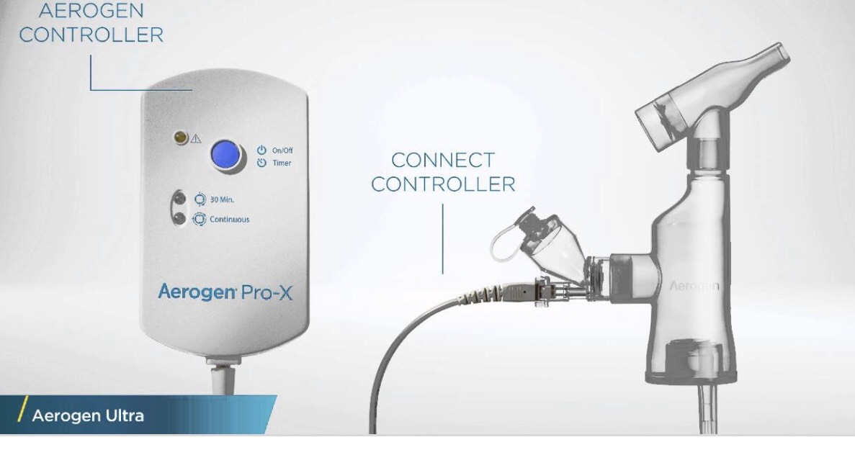
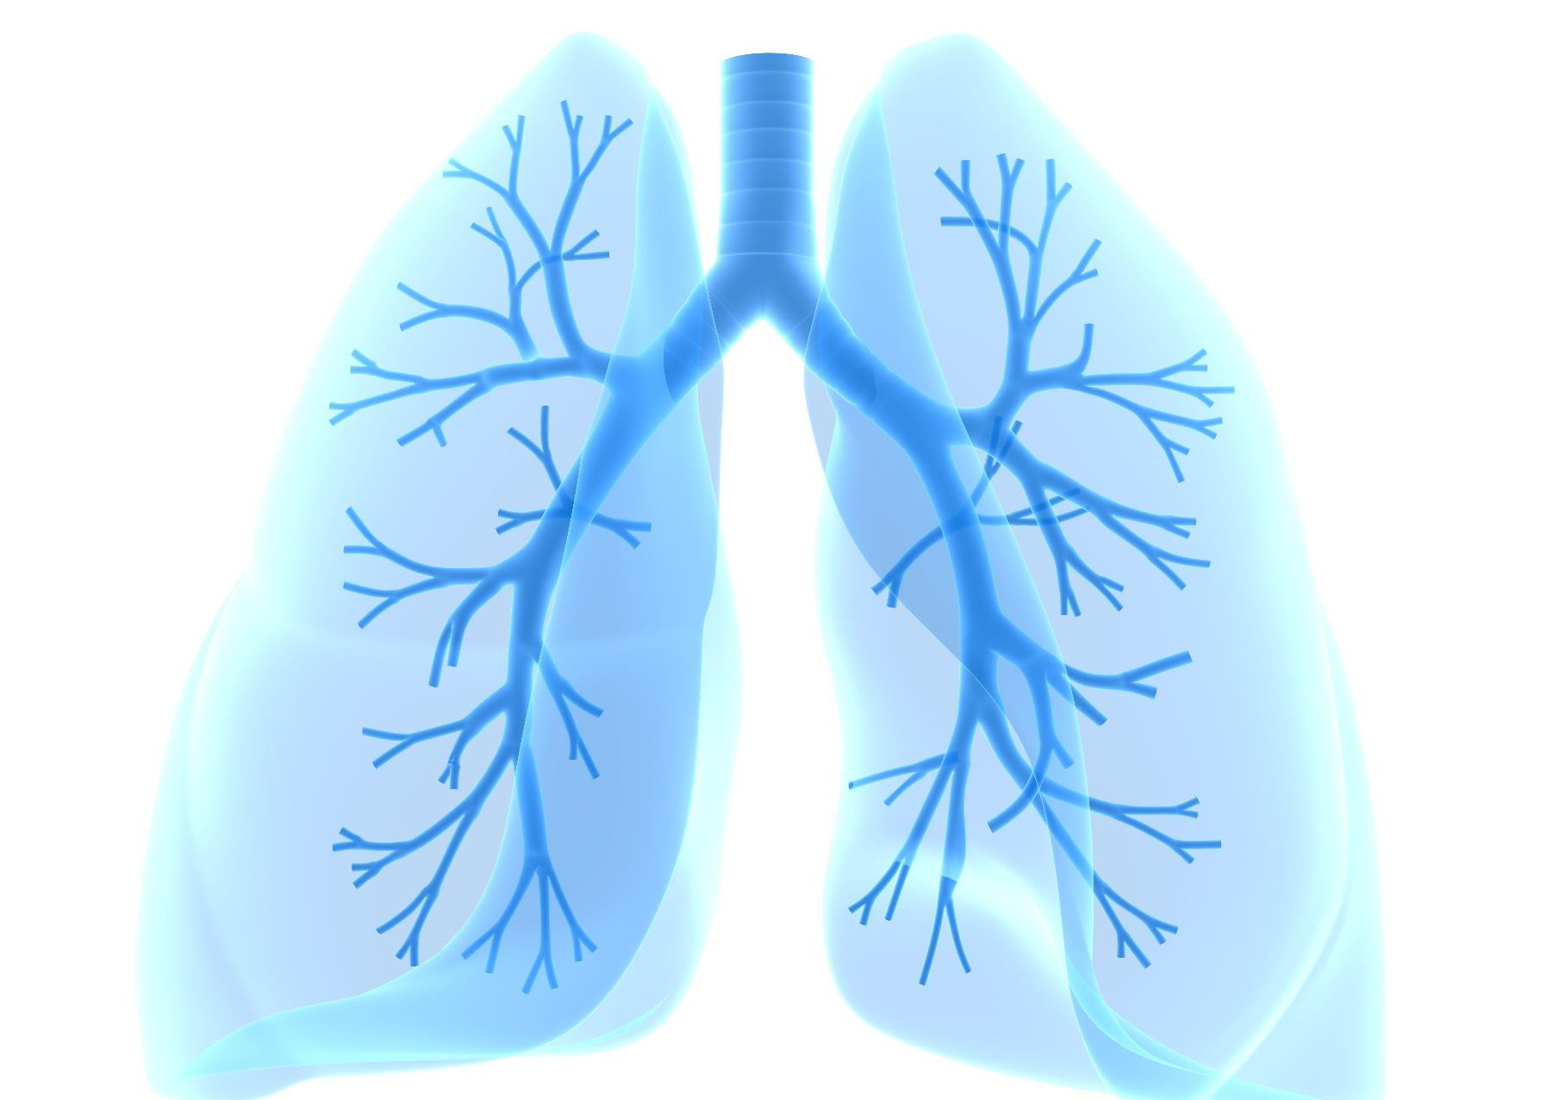
BRAVE
Borg score outcomes in Respiratory comprimised Acute exacerbating COPD patients receiving treatment via vibrating mesh nebulisern Vs jet nebuliser in the Emergency Department
  To compare clinical end points of patients treated with jet vs.vibrating mesh nebulisers using oscillometry.
      Inclusion Criteria
        Age ≥ 18
        Willing and able to provide written informed consent
        Diagnosis of COPD
        Acute exacerbation of COPD
Contact Research Team 82054
emquire.care

